Slide 1
OCR & Document Understanding
From a raw PDF to structured markdown — layout detection + a small vision-language model, working together.
PDF
REGIONS
MD
Qwen/Qwen3.5-0.8B · DocLayout-YOLO · PyMuPDF

Slide 2
VIDEO SERIES
Part of a Series: How to Build Your First Chatbot
Real documents, real models, real measured results — not toy examples.
1
OCR & Document Understanding
PDF → structured markdown
YOU ARE HERE
2
Analysis & Validation
Is the extraction actually right?
3
Chunking
Splitting documents for retrieval
4
Embedding & Database
Vectors, Postgres, pgvector
5
Database Deep Dive
Search, indexes, and what Postgres actually does
6
Summarization
Retrieval + a real LLM + a UI
Series context reproduced from the provided Module 1 deck.

Slide 3
INTRO
OCR Used to Mean One Thing
The modern shift is separating “where/what is it?” from “what does it say?”.
CLASSIC OCR
MODERN DOCUMENT UNDERSTANDING
PAGE
TEXT
STRING
1
2
3
LAYOUT
CROP
VLM
where + what?
region pixels
what does it say?
Everything becomes characters. Tables, columns, and figures lose their identity.
Different region types get different extraction behavior.

Slide 4
DID YOU KNOW
OCR Has Been Around Longer Than You’d Think
A quick timeline to frame how different today’s VLM-based approach really is.
1929
1970s
1980s
2000s+
Today
Tauschek patent
Reading machines
Tesseract at HP
Open source + ML
Layout + VLM
mechanical letterform matching
OCR becomes assistive technology
software OCR matures
OCR becomes widely accessible
recognize structure and meaning
For most of OCR history, the target was characters. This module treats the page as a structured visual scene first.
Historical milestones summarized from the provided Module 1 deck; image use is avoided here to keep the timeline legible.

Slide 5
THE PROBLEM
A PDF Page Is Not Just Text
Before extraction, the page is a visual layout problem.
TITLE
Paragraph
transcribe text
TEXT
TABLE
Table
preserve rows + columns
Figure
classify + describe
Logo / signature
metadata, not body
FIGURE
STAMP
Header / footer
drop from body, still log
The extraction question only makes sense after the region type is known.

Slide 6
ARCHITECTURE
Seven Steps, PDF to Markdown
The useful teaching idea: every step leaves something inspectable behind.
1
2
3
4
5
6
7
PDF → image
layout detection
visualize boxes
VLM extraction
region routing
assembly
validate + metadata
Teaching checkpoint: the pipeline never jumps straight from a PDF to “the answer.” It creates intermediate evidence at every stage.

Slide 7
TEACHING BUILD
Watch the document become structured · Step 1 of 4
Use these four slides as a click-through animation while explaining the architecture.
RAW PDF PAGE
PAGE IMAGE
DETECTED REGIONS
STRUCTURED
MARKDOWN
TITLE
Start with the page as a document — not a text string.

Slide 8
TEACHING BUILD
Watch the document become structured · Step 2 of 4
Use these four slides as a click-through animation while explaining the architecture.
RAW PDF PAGE
PAGE IMAGE
DETECTED REGIONS
STRUCTURED
MARKDOWN
TITLE
pixels
Render to pixels because the layout detector is a vision model.

Slide 9
TEACHING BUILD
Watch the document become structured · Step 3 of 4
Use these four slides as a click-through animation while explaining the architecture.
RAW PDF PAGE
PAGE IMAGE
DETECTED REGIONS
STRUCTURED
MARKDOWN
TITLE
title
text
pixels
table
Detect and label regions before asking a VLM to read anything.

Slide 10
TEACHING BUILD
Watch the document become structured · Step 4 of 4
Use these four slides as a click-through animation while explaining the architecture.
RAW PDF PAGE
PAGE IMAGE
DETECTED REGIONS
STRUCTURED
MARKDOWN
TITLE
title
## Title
Paragraph…
<table>…
text
pixels
table
metadata.json
regions.json
Route each region differently, then assemble markdown + metadata.

Slide 11
STEP 1 OF 7
PDF → Image
PyMuPDF renders each page to pixels so vision models can operate on the same representation for scanned and digital PDFs.
PDF INTERNALS
WHY THIS NORMALIZATION HELPS
1
Vision-ready
layout detector sees pixels
text objects
vector lines
embedded image
2
Scan-safe
works on image-only PDFs too
3
Reproducible
same visual input for every model
render
4
Metadata-safe
native PDF metadata is captured separately
200 DPI PNG
Technical reference: PyMuPDF Page.get_pixmap() — https://pymupdf.readthedocs.io/en/latest/page.html

Slide 12
STEP 2 OF 7
Layout Detection — DocLayout-YOLO
The detector answers two questions at once: where is a region, and what class is it?
10 REGION CLASSES
title
title
plain text
plain text
table
figure
figure caption
table caption
table
abandon
table footnote
formula
formula caption
abandon
Real run examples in the provided deck: 19 regions on a Federal Register page; 15 on a NASA factsheet page.
Technical reference: DocLayout-YOLO GitHub / paper — https://github.com/opendatalab/DocLayout-YOLO · https://arxiv.org/abs/2410.12628

Slide 13
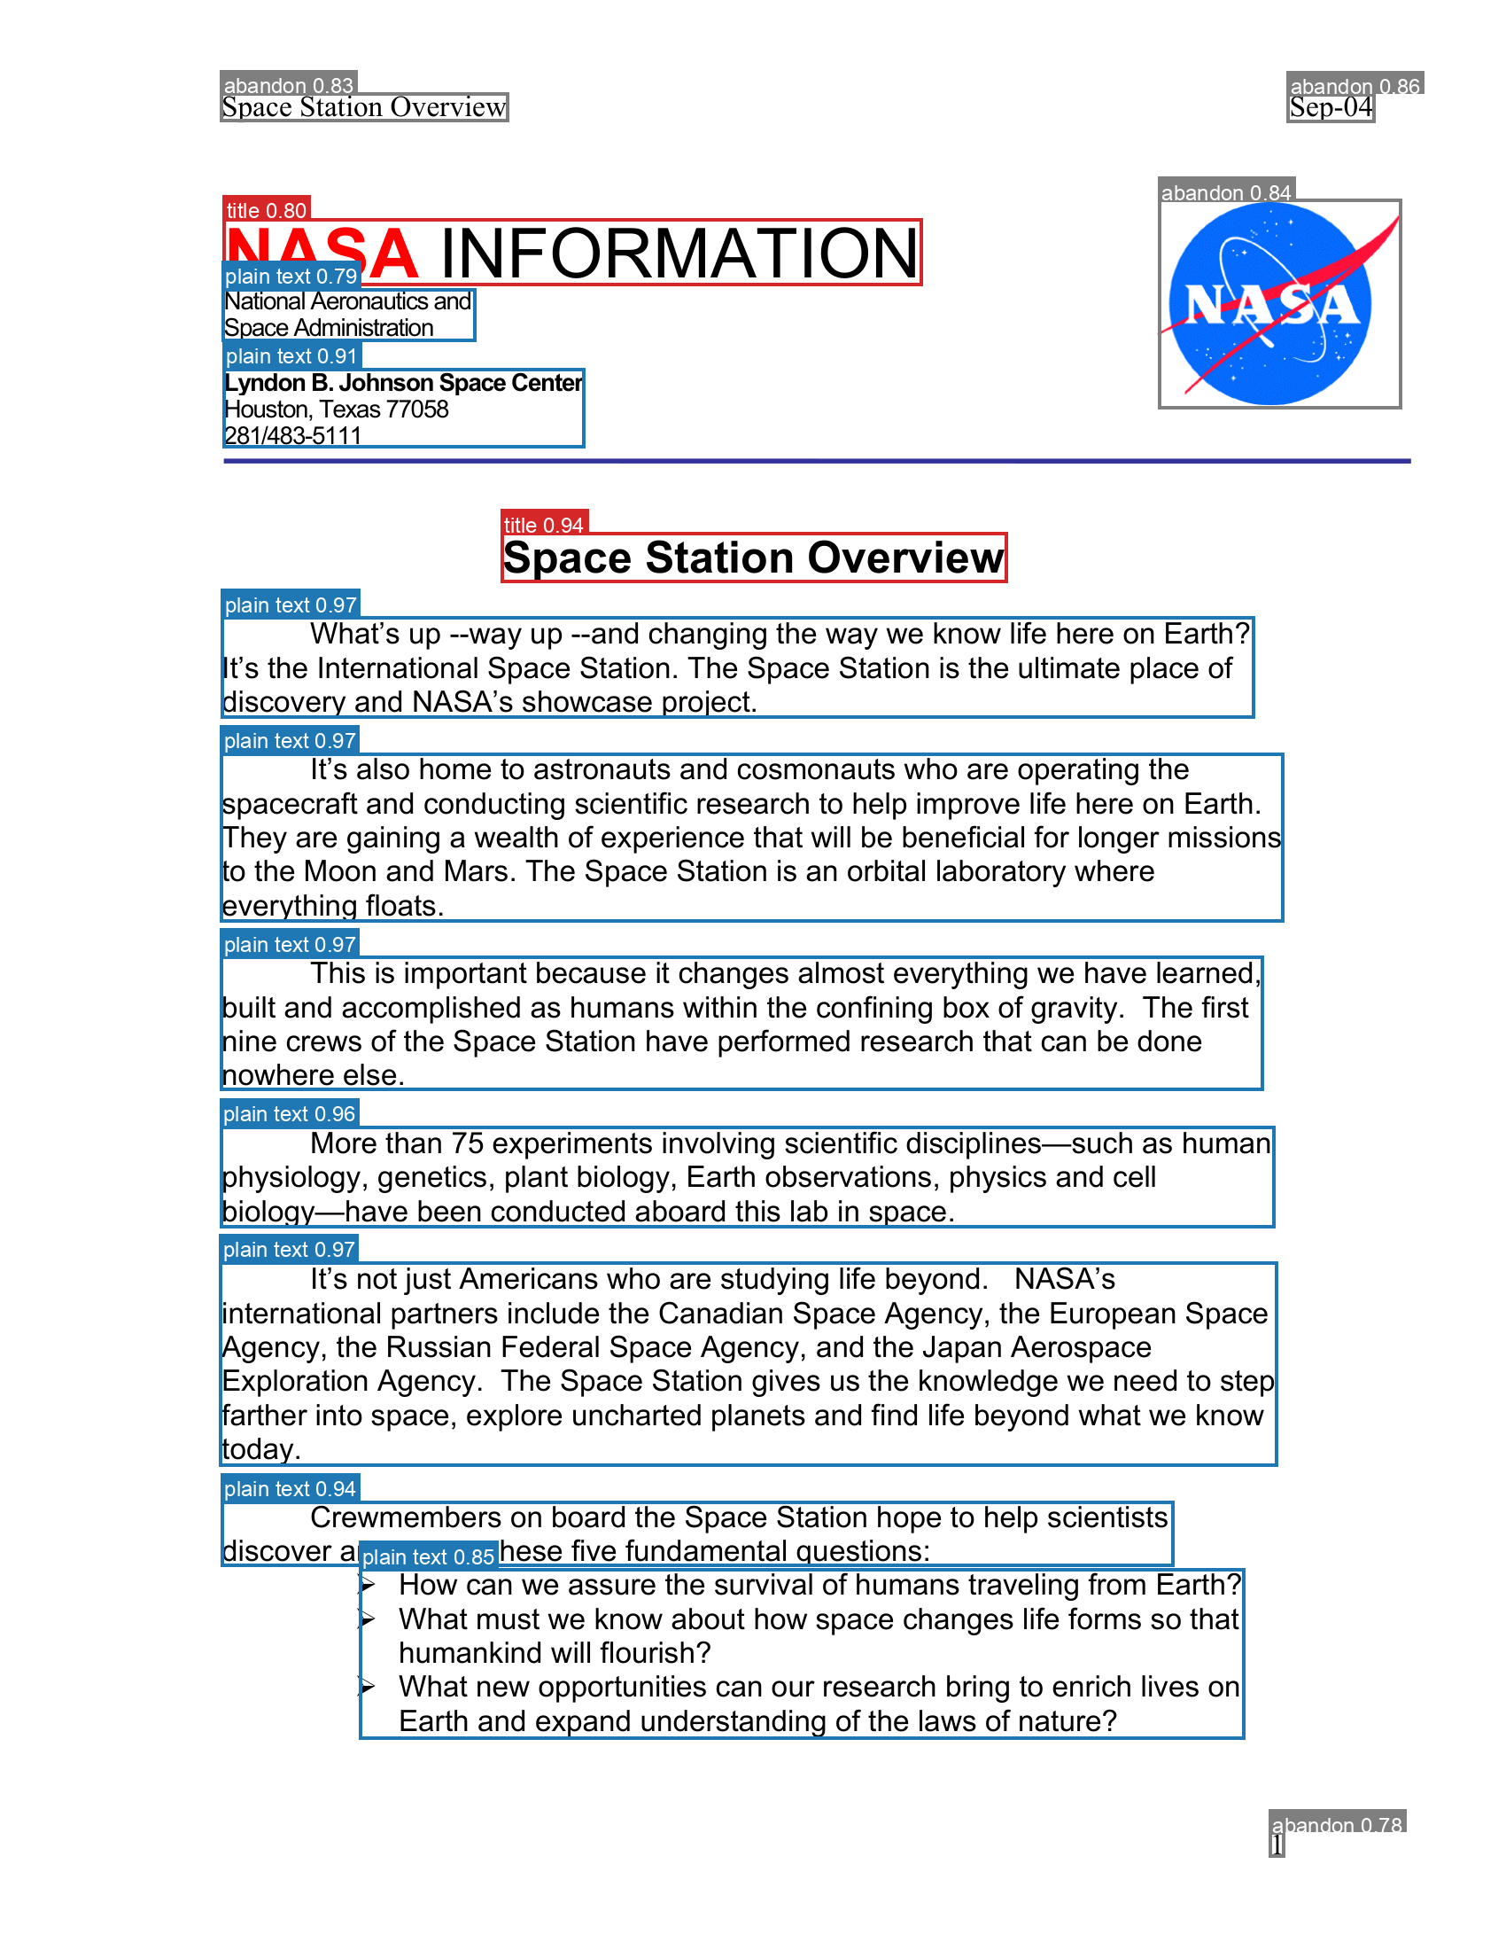
STEP 3 OF 7
Seeing What the Model Actually Found
Draw the raw boxes before extraction. This makes detector mistakes visible before a VLM can hide them.
REAL FINDING
NASA logo → “abandon”
The detector correctly finds most of the page — but the top-right NASA logo is classified as page furniture rather than a figure.
Why it matters
✓
It stays traceable in metadata.
✓
It is not silently promoted to body text.
✓
Visualization turns a model error into a teachable observation.
Annotated page image: from the provided Module 1 deck / real pipeline output.

Slide 14
STEP 4 OF 7
The Vision-Language Model — Qwen3.5-0.8B
One small local model, three extraction behaviors controlled by prompts.
0.8B
TEXT
Transcribe exactly
title · paragraph · caption · formula
parameters
TABLE
Image → HTML
rows · columns · headers
CUDA → Apple MPS → CPU
FIGURE
Classify + describe
chart · photo · logo · signature
Small enough to run locally — and small enough to make useful, inspectable mistakes.
Same model, different prompt = different structured task.
Technical reference: Qwen/Qwen3.5-0.8B model card — https://huggingface.co/Qwen/Qwen3.5-0.8B

Slide 15
THE ACTUAL PROMPTS
Prompt 1 of 3 — Plain Text / Title / Caption / Formula
One strict transcription prompt covers every text-bearing region class.
Transcribe all text in this image exactly as written.
Return plain text only, no commentary, no markdown formatting.
INPUT REGION TYPES
title
plain text
caption
formula
OUTPUT: plain text only

Slide 16
THE ACTUAL PROMPTS
Prompt 2 of 3 — Table → HTML
Preserve table structure so the markdown contains a real table, not a wall of numbers.
Convert this table image into a single valid HTML <table> element, preserving all rows, columns and header cells. Return only the HTML markup, no markdown code fences, no commentary.
TABLE IMAGE
A
B
C
<table>…</table>

Slide 17
THE ACTUAL PROMPTS
Prompt 3 of 3 — Figure Classify + Describe
The returned TYPE controls routing; the description becomes useful body context for content figures.
Classify it as exactly one of: chart, photo, diagram, logo, signature, stamp_seal, other.
Reply in exactly this format:
TYPE: <type>
DESCRIPTION: <description>
TYPE → ROUTING DECISION
chart / photo / diagram
BODY
logo / signature / stamp
METADATA
other
REVIEW
One inference call → both classification and description.

Slide 18
REAL FINDING
Small Models Don’t Always Follow Instructions
Prompt instructions are requests — never treat them as load-bearing validation.
PROMPT SAYS
DEFENSIVE PIPELINE
“no markdown code fences”
verify shape
1
2
strip fence
MODEL DOES
3
validate table tags
```html
<table> ... </table>
```
Lesson: verify outputs, not prompt intentions.

Slide 19
STEP 5 OF 7
Region Routing — Not Everything Becomes Body Text
Routing is where region type becomes a document policy.
BODY CONTENT
METADATA ONLY
DROPPED FROM BODY
✓
title → ## heading
✓
logo
✓
headers
✓
plain text / captions / formulas
✓
signature
✓
footers
✓
table → raw HTML
✓
stamp / seal
✓
watermarks
✓
chart / photo / diagram → image + description
✓
artifact description + location
✓
abandon regions — still logged
A good extraction pipeline decides what should not become “content” just as deliberately as what should.

Slide 20
STEP 6 OF 7
Assembly — Reading Order
Top-to-bottom, then left-to-right works for single-column pages — and fails visibly on true two-column layouts.
SINGLE COLUMN
TWO COLUMNS
1
1
2
2
3
4
3
5
6
4
5
simple sort → correct order
naive global sort interleaves columns
Fix: detect columns first, then sort within each column.

Slide 21
STEP 7 OF 7
Post-Processing, Validation & Metadata
The final markdown is only one artifact; the layout evidence stays available for later modules.
<doc>.md
metadata.json
regions.json
•
reading-order text
•
native PDF metadata
•
true class
•
raw HTML tables
•
region counts
•
confidence
•
figure descriptions
•
artifacts
•
page + bbox
•
low-confidence + dropped
•
clean per-region text
Module 3 reads regions.json to avoid re-guessing structure from markdown.

Slide 22
ENGINEERING DETAIL
Running on Real Hardware, Not Just “a GPU”
The backend-selection logic is part of reliability: the batch should degrade gracefully, not die halfway through.
CUDA
NVIDIA GPU
MPS
Apple Silicon
CPU
universal fallback
1
device absent
2
kernel unsupported at runtime
3
--device flag
fail immediately
warn + retry on CPU
force backend for comparison
Reliable local AI = explicit fallback behavior, not “works on my GPU.”

Slide 23
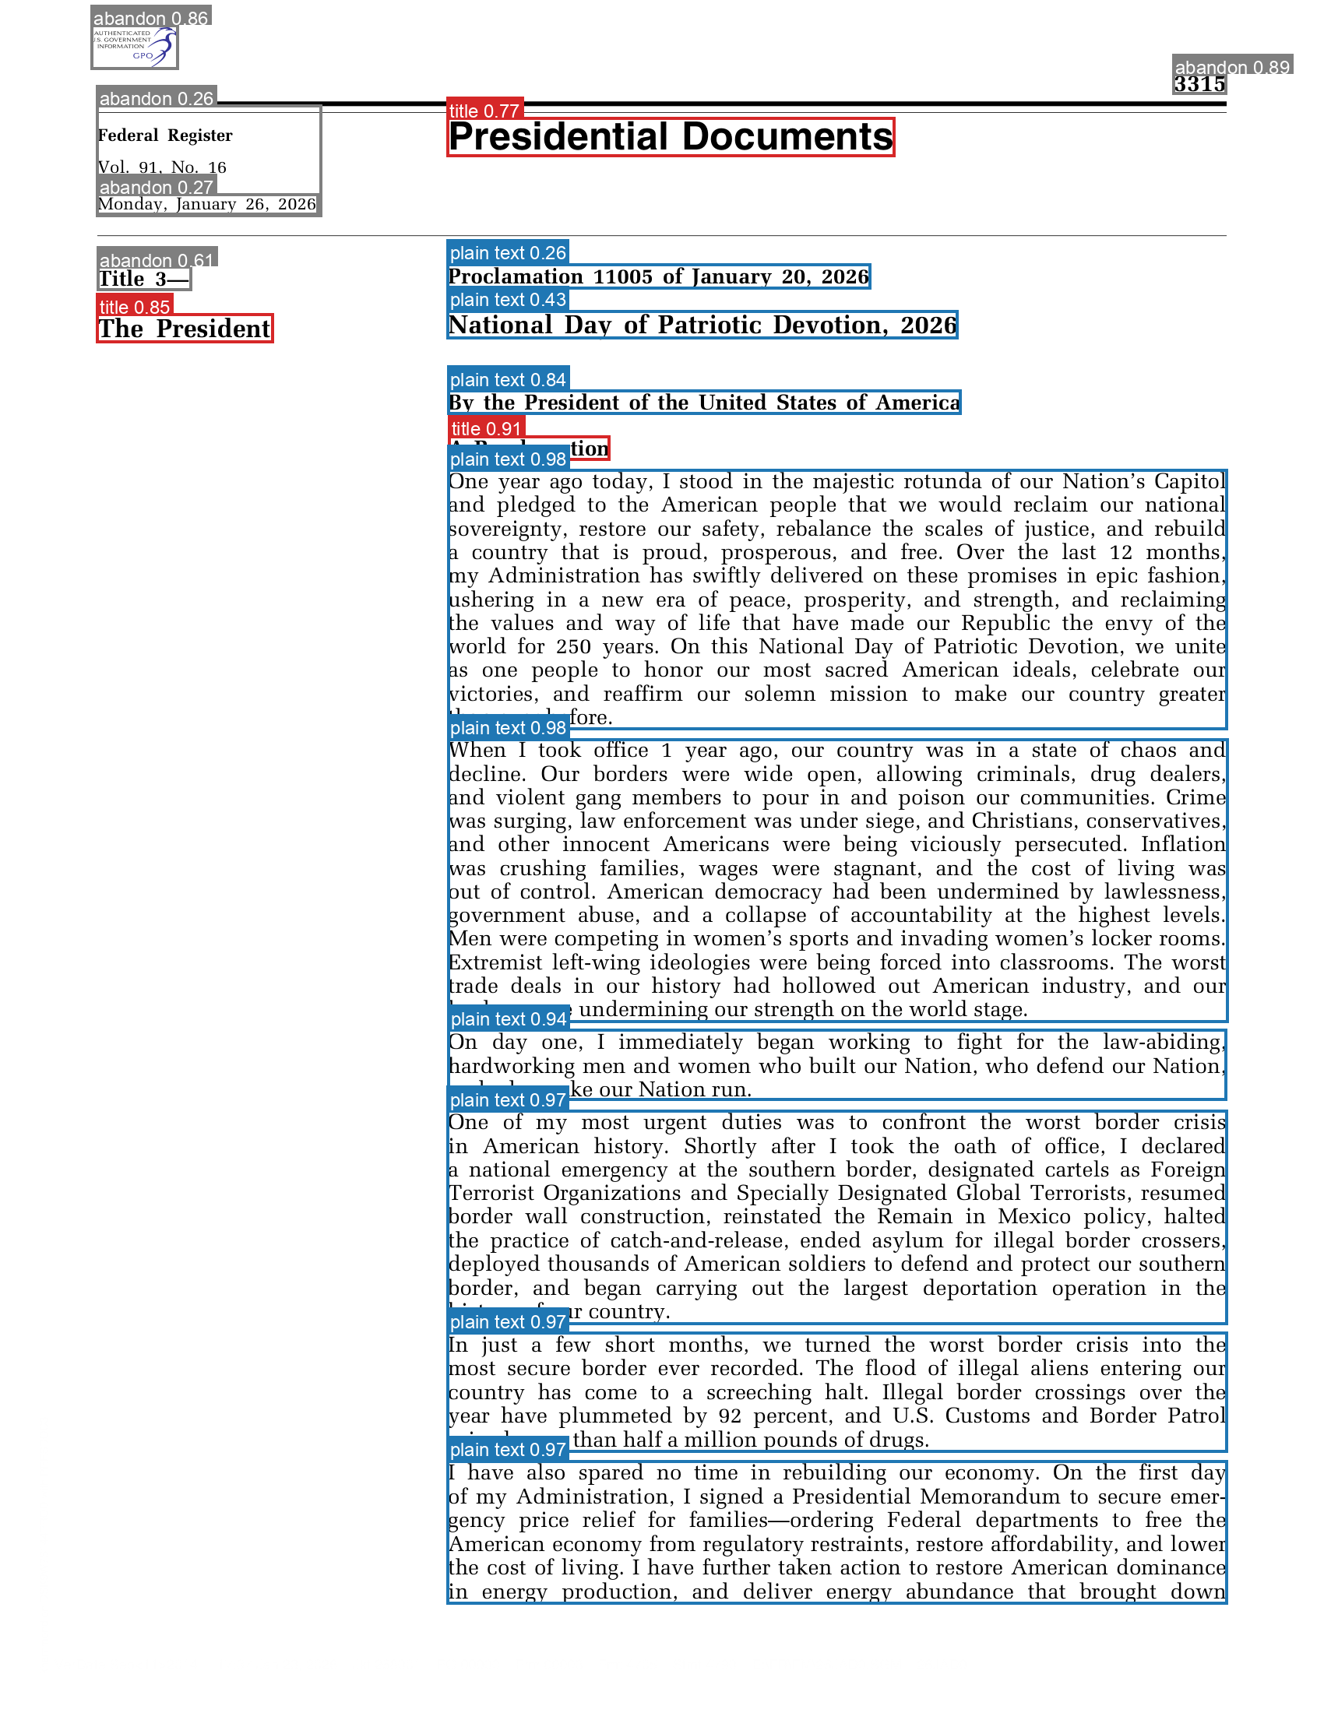
REAL BUG
The Same Text, Boxed Twice
Cross-class overlap can cause duplicate transcription even when both detections look individually plausible.
BUG
“A Proclamation”
The same line is detected as both title and plain text. Both are sent to OCR, so the markdown contains it twice.
What is missing?
Cross-class overlap suppression — e.g., an IoU-based rule that decides which overlapping detection wins.
Great class exercise: define the deduplication policy.
Annotated page image: from the provided Module 1 deck / real pipeline output.

Slide 24
REAL FINDING
Small Models Can Be Confidently Wrong
A model can capture the gist of a chart while inventing the details that matter.
ACTUAL CHART
MODEL DESCRIPTION
Q3 Regional Output
“Q5 Regional Output … 40 to 80,000 units”
✓ correct gist: bar chart, four regions
✕ wrong title
✕ invented magnitude
North
South
East
West
40–80 units
Before trusting a VLM to read chart numbers unsupervised, validate the precise values — not just the semantic gist.

Slide 25
WRAP-UP
What Module 1 Actually Produces
The important outcome is not just markdown — it is a set of inspectable artifacts for downstream validation and retrieval.
pages/
rendered PNGs
annotated/
layout boxes
images/
cropped figures
<doc>.md
structured content
metadata.json
summary + flags
regions.json
full layout evidence
Module 2 validates these outputs → Module 3 converts validated regions into retrieval-ready chunks.

Slide 26
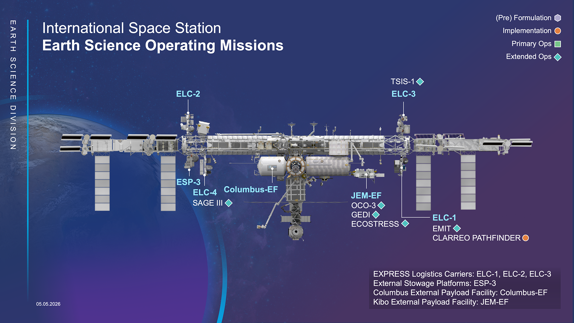
SOURCES
Internet Visuals & Technical References
1
PyMuPDF page rendering
pymupdf.readthedocs.io/en/latest/page.html
2
DocLayout-YOLO
github.com/opendatalab/DocLayout-YOLO
3
DocLayout-YOLO paper
arxiv.org/abs/2410.12628
4
Qwen3.5-0.8B model card
huggingface.co/Qwen/Qwen3.5-0.8B
5
Measured findings / screenshots
Provided OCR_Module_Overview.pptx
Internet visual used in this deck
NASA Scientific Visualization Studio — International Space Station Earth Science operating missions graphic.
No AI-generated imagery is used. All teaching diagrams are native PowerPoint shapes; the NASA graphic is web-sourced and cited above.
https://svs.gsfc.nasa.gov/30280

Slide 27
Questions?
1. OCR/ — README.md has the full pipeline detail, every prompt, and every finding in this deck.
Module 1 · Data Processing → Analysis → Chunking

